Slide 1
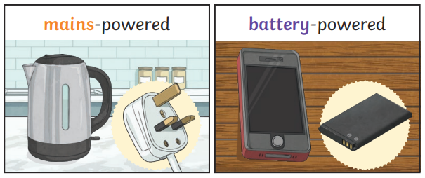
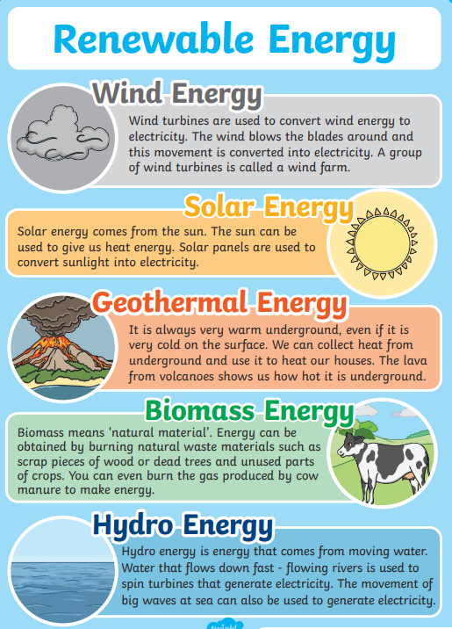
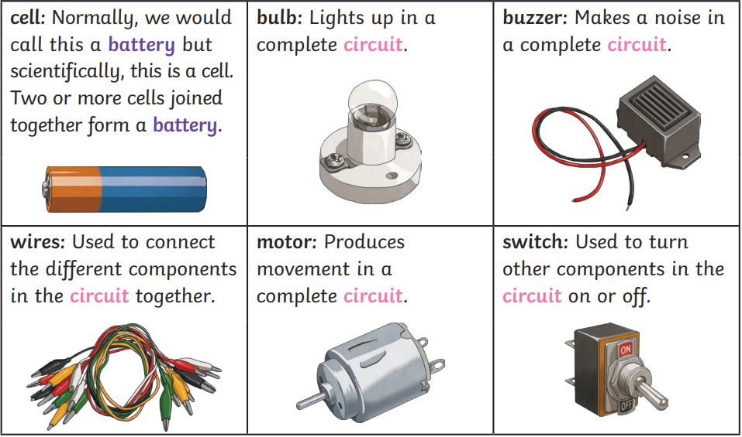
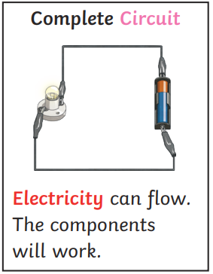
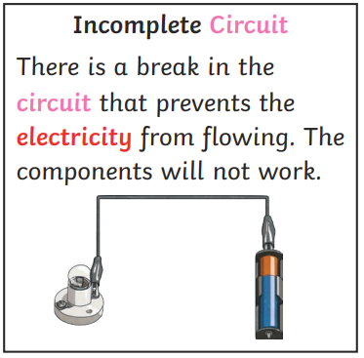
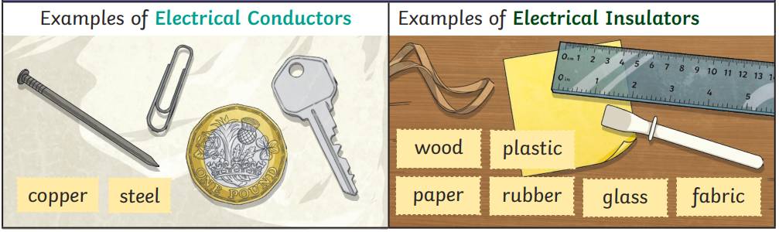
How can we switch off?
KNOWLEDGE ORGANISER
ESSENTIAL VOCABULARY
electric grid | An interconnected network for electricity delivery from producers and consumers.
mains power | Electricity that is delivered to homes and businesses through an electric grid.
battery power | The power discharged from a disposable storage system.
battery | A container consisting of one or more cells in which chemical energy is converted into electricity.
wind power | The process by which wind is used to generate power or electricity.
electrical power | The rate in which energy is transformed into an electrical circuit.
hydro power | A renewable source of energy that generates power through the use falling or fast running water.
solar power | A source that uses light and heat from the sun to generate power.
fossil fuel | A material that is formed naturally in the Earth’s crust from the remains of dead plants and animals. It is extracted and burned as fuel.
geothermal | A type of renewable energy taken from the Earth’s core.
circuit | A path built up of individual electronic components in which an electrical current can pass through.
buzzer | An audio signalling device often included in timers and alarms.
motor | A device that converts electrical energy into mechanical energy to create movement.
switch | A device that completes, diverts or breaks a circuit.
wire | A flexible conductor used to carry electrical current in a circuit.
conductor | A material that allows an electrical current to pass through it.
insulator | A material that does not allow an electrical current to pass through it.

Slide 2

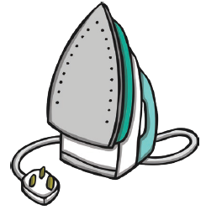
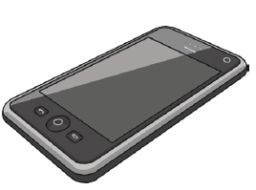
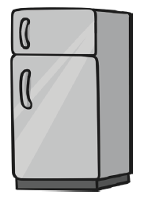
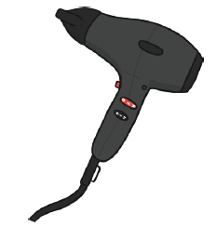
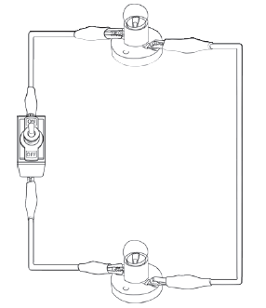
Assessment
1. Label these items to show if they are mains or battery powered.
____________
____________
____________
____________
____________
2. Complete the sentences…
A battery is a collection of __________ A _________ completes, diverts or breaks a circuit __________ connect the different components in a circuit.
3. True or false?
The light bulb in this circuit will work. Explain.
4. Write down 3 types of powers
1. ___________________ 2. ___________________ 3. ___________________
5. Write a definition …
Conductor: ___________________________________________________________________ Insulator: ____________________________________________________________________

