Slide 1
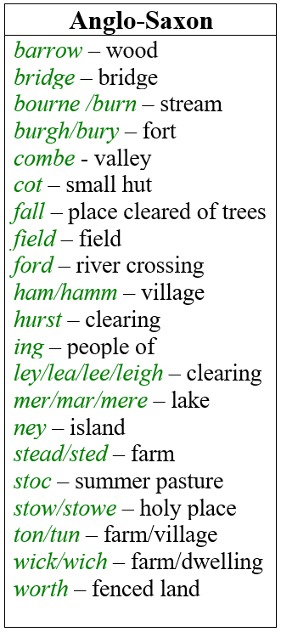
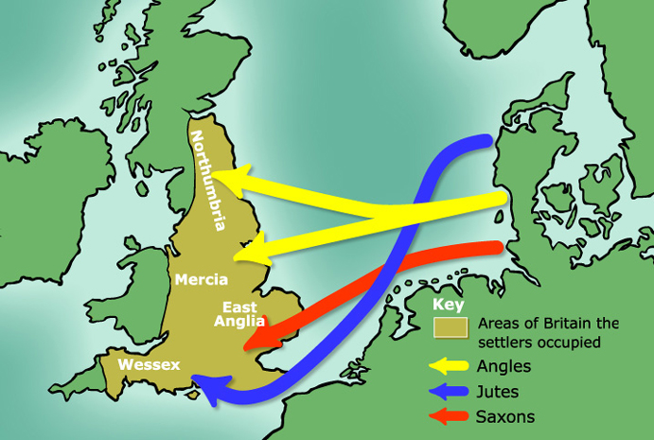
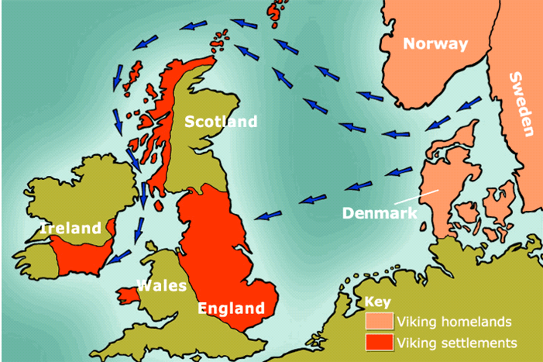
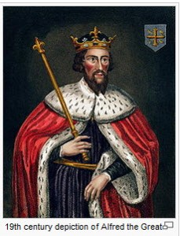
Who stood here before us?
KNOWLEDGE ORGANISER
ESSENTIAL VOCABULARY
artefact | An object made by a human being which is of interest to an archaeologist
invaders | A person or group who enters an area and take control of it by force
settlers | A person who moves with a group of others to live in a new country or area
shield | A piece of metal or other material held by straps or handles used for protection
Angles, Saxons and Jutes | The three biggest Anglo-Saxon tribes that settled in what we now know as Britain
tribes | A social group made up of many families and generations that share the same language and beliefs.
kingdoms | An area ruled by a king
origins | The point or place where something begins
archaeologist | A person who studies human history and prehistory through the excavation of sites and the analysis of artefacts
united | Joined together for a common purpose or by common feelings
tension | A feeling of fear or anger between two groups of people who do not trust each other
raiders | A person who attacks an enemy in their territory
Anglo Saxons | A group that settled in what is now England in the Early Middle Ages
Vikings | A group of Scandinavian seafaring pirates and traders who raided and settled in what is now Britain and Ireland.
clay | A natural soil material containing minerals which can be moulded when wet and hardens when dries or is fired
moulded | To make a soft substance have a particular shape
Three of the biggest Anglo-Saxon tribes that settled.
The Vikings travelled in longships to what we now call Britain and Ireland as their homelands were flooding. They settled here.
King Alfred of Wessex
King Alfred ruled from 871 – 899. He made peace with the Vikings and some of them settled in their own area of eastern England called Danelaw.

Slide 2
Assessment
1. Label the definitions either invaders or settlers
A group of people who travel to a new area or country to live A group of people who enter a new area or country to take control by force.
4. What did King Alfred do that helped remove the tension between the Anglo-Saxons and the Vikings?
___________________________________________________________________________________________________________________________________________________________________________________________________________________________________________________________________
2. How do we know that the Anglo-Saxons settled in Britain?
______________________________________________________________________________________________________________________________________________________________________________________________________________________________________________________________________________________________________________________________________________________________________________
5. List 3 things that you would find in an Anglo-Saxon village.
__________________________________ __________________________________ __________________________________
3. What was excavated at Sutton Hoo?
________________________________________ ________________________________________________________________________________________________________________________
6. Why did the Vikings have to travel to what we now call Britain?
______________________________________________________________________________________________________________________________________________________

