Slide 1
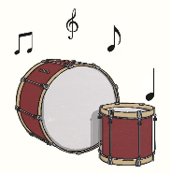
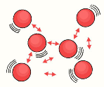
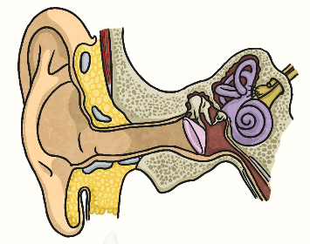
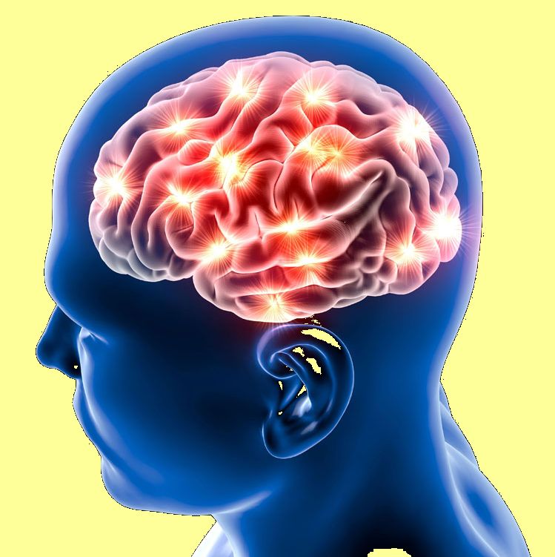
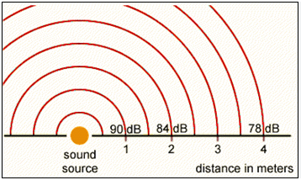
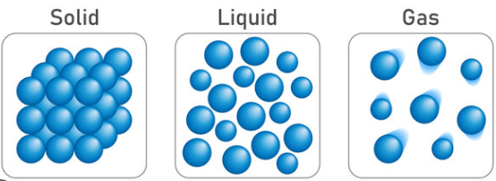
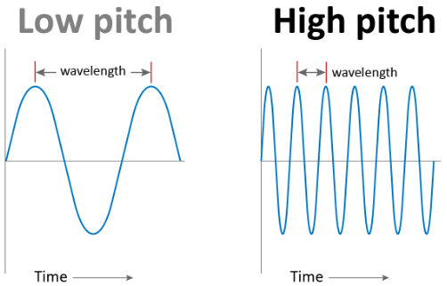
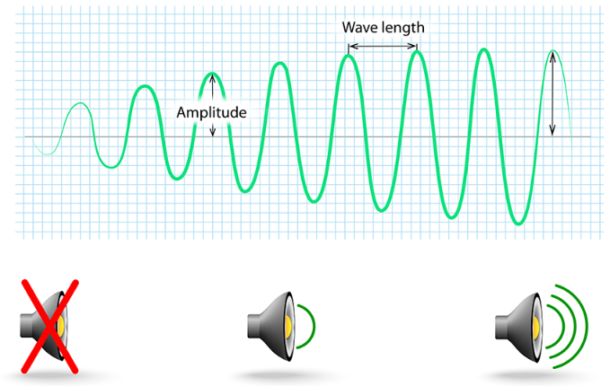
What is sound?
KNOWLEDGE ORGANISER
ESSENTIAL VOCABULARY
sound | Sound is a type of energy. Sounds are created by vibrations.
Soundproof | To prevent sound from passing through
particles | Solids, liquids and gases are made of particles. They are so small, we are unable to see them.
Eardrum | A part of the ear which is a thin, tough layer of tissue that is stretched out like a drum skin. It separates the outer ear from the middle and inner ear. Sound waves make the ear drum vibrate.
medium | Something that makes possible the transfer of energy from one location to another.
Insulation | protect from heat, cold, or noise
Evaluate | Evaluating is the process of deciding if something has been done in the best way and wondering what could be improved.
volume | The loudness of a sound. Measured in Decibels (Db)
source | Where something comes from.
vibration | A quick movement back and forth. Fast vibrations = high pitch.
pitch | How low or high a sound is
Sound wave | Vibrations travelling from a sound source.
amplitude | The size of a Vibration. A larger amplitude = a louder sound.
The steps to hearing a sound
Particles vibrates which makes the sound
Air vibrations enter your ear as sound waves.
Your brain processes the sound and decides what it was.
Hit the drum
Particles
Distance and sound
Sound needs a medium to travel through. It travels best through a solid because the particles rub against each other and pass on the vibration.
Sound Waves - Pitch
A low pitch sound is created when the sound waves are further apart. A low pitch is a low sounding sound. A high pitch sound is created when the sound waves are close together. A high pitch is a high sounding sound.
Sound Waves - Volume
As the volume gets higher, the sound waves get taller.

Slide 2
Assessment
Question 1: Which medium does sound travel best through?
Solid
Liquid
Gas
If the sound has further to travel, it will be…
Quieter Louder

