Slide 1
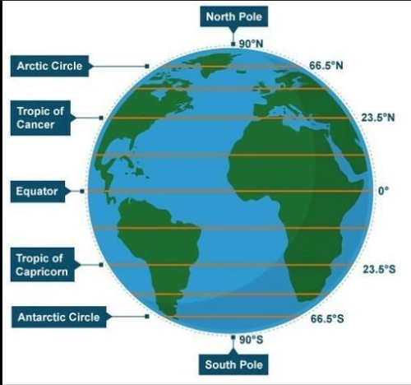
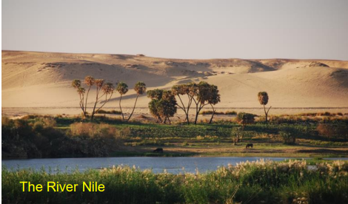
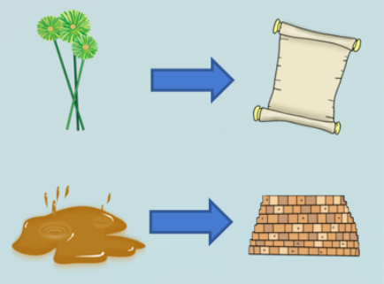
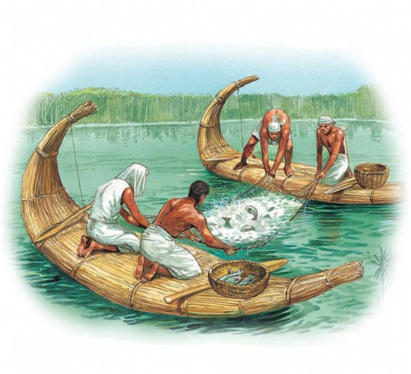
Why do we live here?
KNOWLEDGE ORGANISER
ESSENTIAL VOCABULARY
equator | Imaginary line that runs around the centre of the Earth.
tropics | The region of the Earth that lies roughly around the middle of the globe.
hemispheres | Half a sphere – The Earth is divided into the Northern and Southern hemisphere.
Arctic / Antarctic circle | The polar circles found at the most northerly and southerly points of the Earth.
population | The number of people that live in a certain place.
hamlet | A very small settlement with just a group of houses.
village | A very small settlement but may have houses, a primary school, a few shops, a post office and a village hall.
town | Larger than a village, with lots of houses, primary and secondary schools, as well as sometimes having a railway station and shopping centre.
city | The largest type of settlement, containing lots of buildings and lots of people. They usually have hospitals, Universities, shops, offices, many houses and a cathedral.
human geography | The relationship between people, place and the environment. Focuses on where people live, what they do and how they use the land.
physical geography | A study of the Earth’s natural features such as mountains, rives, deserts and oceans. It looks at their changes over time including the effect of climate.
urban | An area where a large number of people live near to each other. Urban areas have lots of buildings and roads.
rural | An area located outside of towns and cities, sometimes called countryside.
vanishing point | The point at which something appears to disappear.
settlement | A place which has previously been uninhabited where people establish a community.
civilisation | A complex human society usually made up of different cities.
one point perspective | A drawing method showing how things appear to get smaller as they get further away towards a single vanishing point on a horizontal line
Features of the Earth
Different types of settlement
Hamlet: A very small settlement which includes a small groups of houses. Village: A small settlement with groups of houses, a primary school, a few vital shops, a Post Office, place of worship and a village hall. Town: A settlement that contains lots of houses, primary and secondary schools. They often have a shopping centre, doctors surgery, place of worship and can include a railway station. City: A large settlement which contains many buildings and home to lots of people. They include shopping centres, schools, universities, sport facilities, offices, hospitals and a cathedral. Mega city: A very large city containing all of the above. A city if considered a mega city when the population greater than 10 million.
Urban and rural comparison
How important was the River Nile to the Ancient Egyptians?
Trade links
Food
Resources – papyrus, bricks, clothing

Slide 2
Assessment
1. Define civilisation
____________________________________________________________________________________________________________________________________________________________________________________
4. Label the definition either urban or rural
A large space of land that is built up with houses, buildings and people. A large space of land that has few houses and buildings.
2. What is the name of the imaginary circle around the centre of the Earth?
Hemisphere Equator Tropic Latitude
5. List 3 things that are essential in a settlement.
____________________________ ____________________________ ____________________________
3. Finish the following sentence…
A settlement ______________________________ ________________________________________________________________________________________________________________________
6. What is the point called in a drawing where parallel lines appear to meet and why do artists use it?
______________________________________________________________________________________________________________________________________________________

