Slide 1
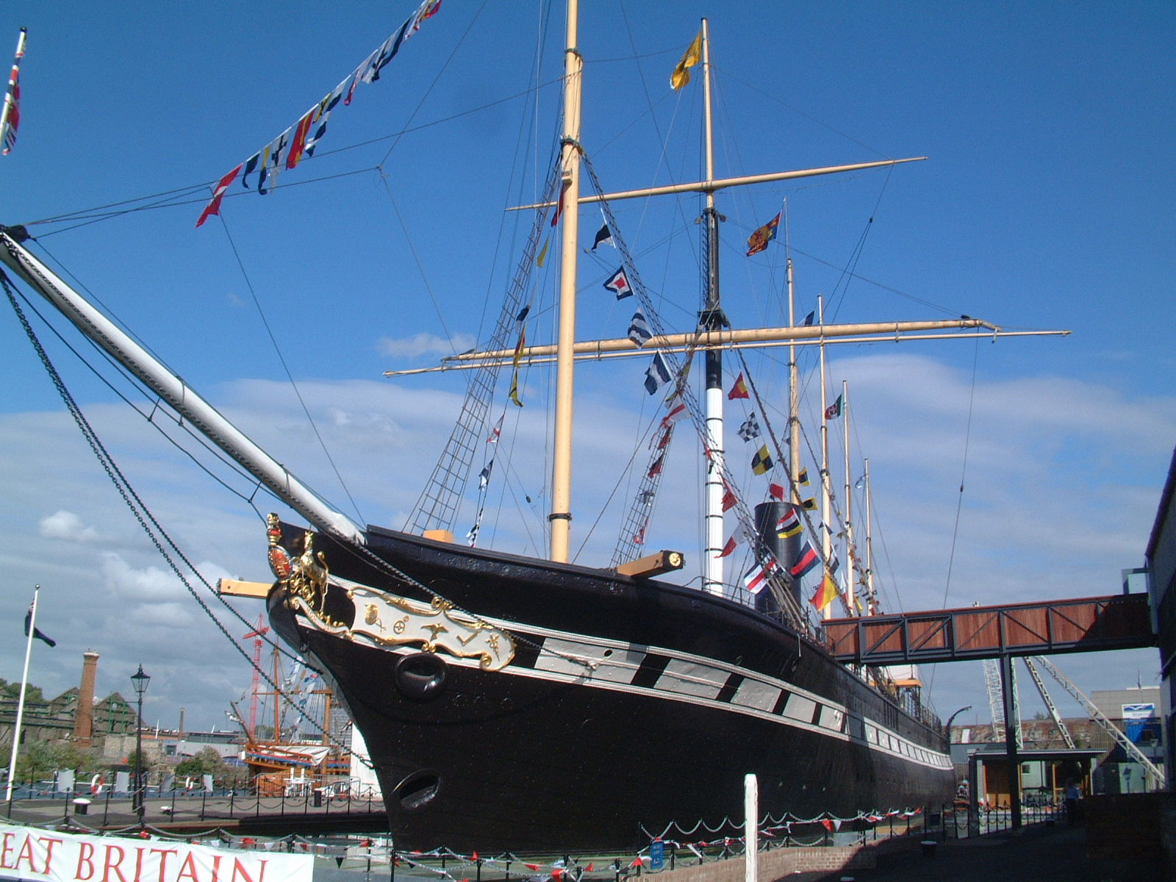
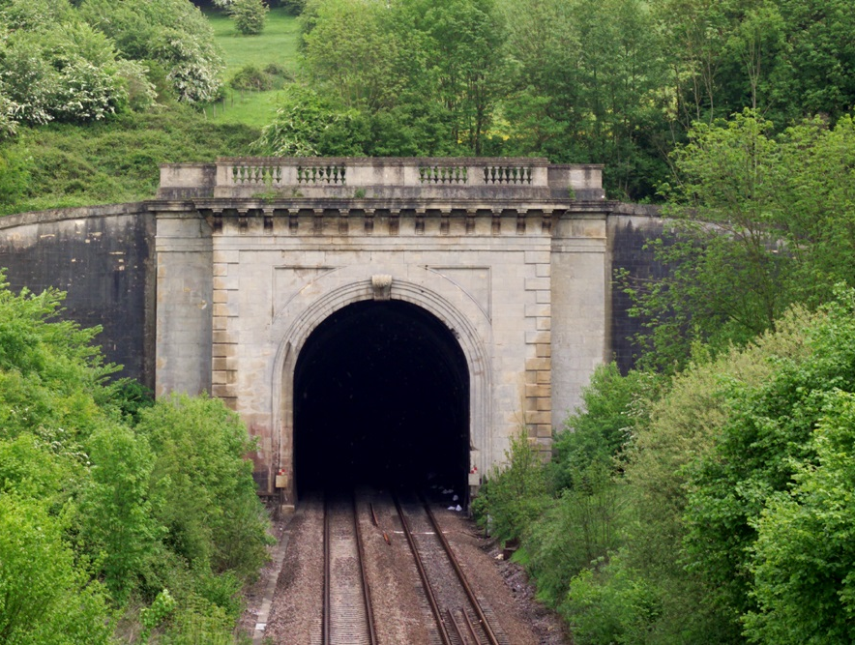
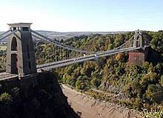
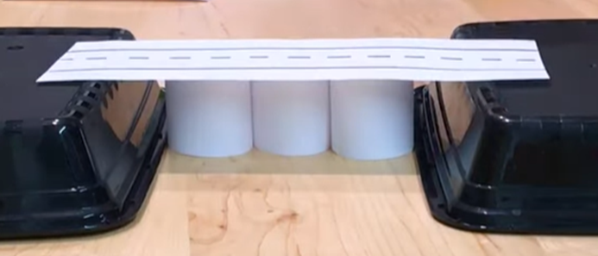

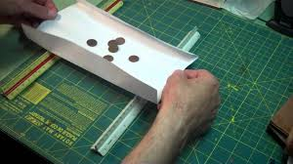
What did Brunel do for Great Britain?
SKILLS AND KNOWLEDGE ORGANISER
VOCABULARY
Significant | being or causing something of importance.
Invent | To think of, come up with, or create something new
Timeline | Dates/times laid out in chronological order
Chronological | In the order that things happened
Impact | The effect of something happening
Past | An event that has happened before now
changed | Something that is different to how it was before
SS Great Britain | Box Tunnel | Clifton Suspension Bridge
How can we make bridges more stable?
Create cylinders
Fold Triangles
Fold up the sides
What will I know by the end of this enquiry?
using common words and phrases relating to the passing of time; ask and answer questions, choosing and using parts of stories and other sources to show that we know and understand key features of events Know how Brunel contributed to national and international achievements. Understand how inventors have had an impact on our lives. generate, develop, model & communicate our ideas through talking build structures, exploring how they can be made stronger, stiffer and more stable
Stable | Not likely to give way or collapse.

Slide 2
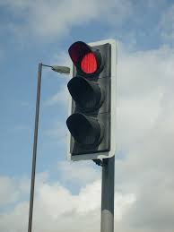
Assessment
Question 3 Which of these is not one of Brunel's inventions?
Question 1: Why did Brunel build the Box Tunnel?
Question 4 Describe a way to make a bridge stonger.
Question 2 Name one impact of the Clifton Suspension Bridge on Bristol.
Question 5
What does the word 'invent' mean?
____________________________________
_____________________________________

