Slide 1
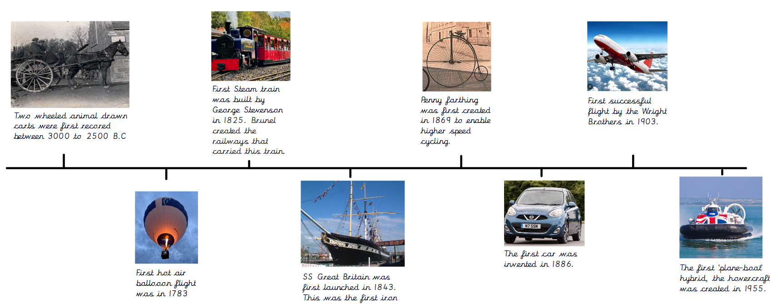
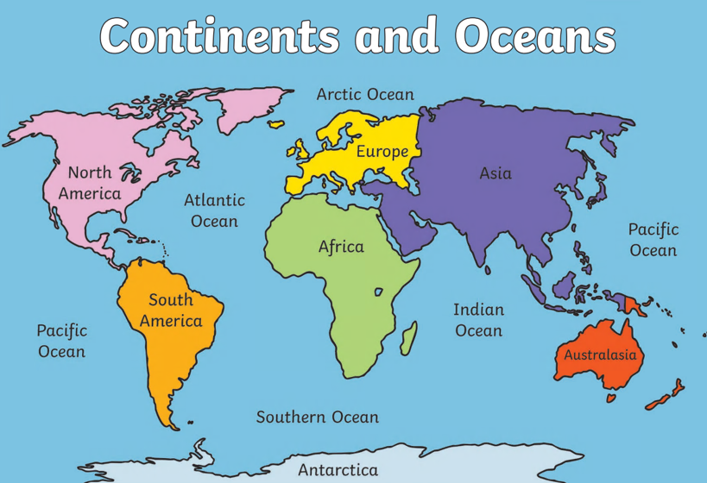
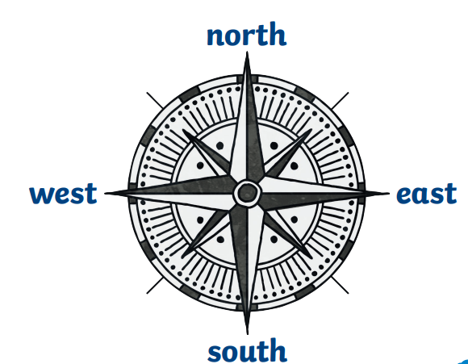
How will we get around in the future?
KNOWLEDGE ORGANISER
VOCABULARY
travel | To go from one place to another, typically over a distance of some length.
future | Something that happens after this moment.
compass | A tool for finding the direction.
direction | The line or course along which something moves, lies, or points.
location | A place or position of something.
model | A small structure showing a final design.
limitation | A limiting rule or circumstance; a restriction.
redesign | To design something again or in a different way.
Compass directions
What should I know by the end of the unit?
Develop an awareness of the past using common words and phrases (before, after) Discuss events of living memory. Use compass directions (N,S,E,W) and find key routes on a map. Name the 7 continent and 5 oceans. Generate, develop design ideas. Select and use a range of tools and equipment best suited for the job. Use wheels and axels to make a mode of transport.

Slide 2
Assessment
Question 1: Complete the compass
Question 3: Name a mode of transport that was invented before and after the SS GB.
Before: __________________________ After: ____________________________
Question 2: What mechanism is useful to help a vehicle move? Draw and label.
Question 4: List all 7 continents.
Question 5: Which ocean is between Europe and America?

