Slide 1
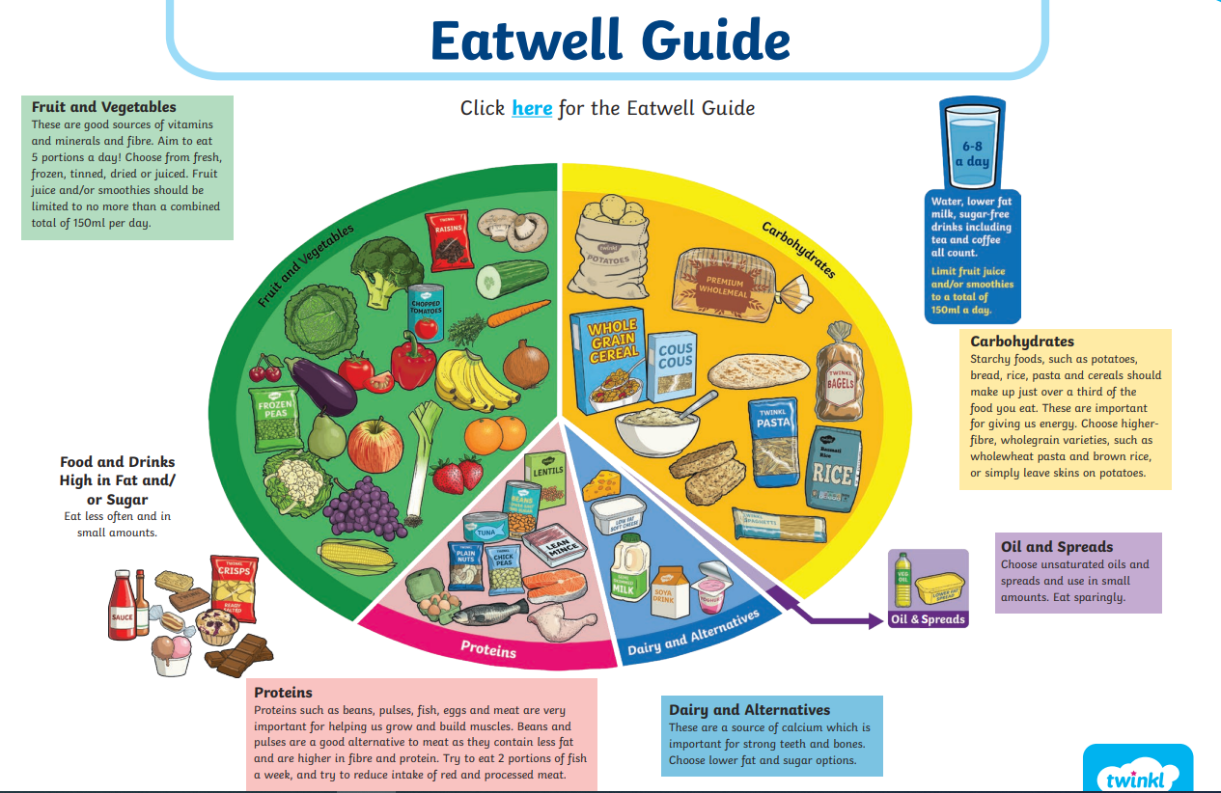
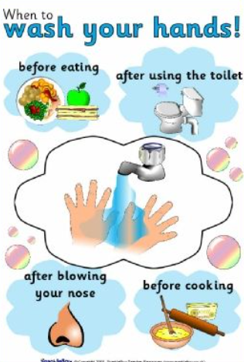
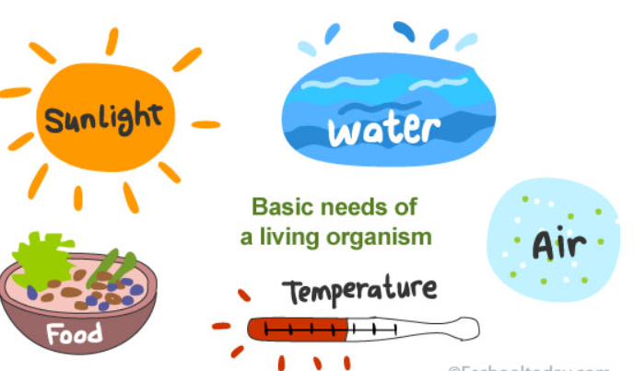
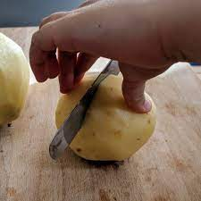

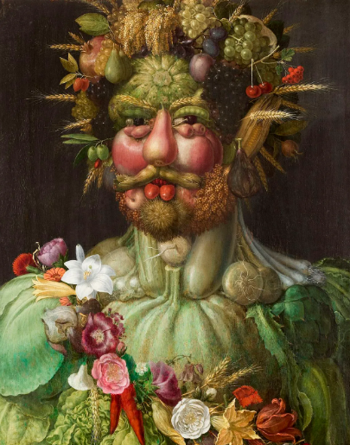
How can I lead a healthy life?
KNOWLEDGE ORGANISER
VOCABULARY
Balanced diet | When you eat the correct amount of nutrients to stay healthy.
Healthy | In good physical and mental condition
Food chain | All animals are dependent on plants or animals as a source of food.
Hygiene | To keep clean in order to prevent disease.
Carbohydrates | A food group which can be found in sugars, starch and cellulose that gives us energy.
Protein | A food group found in pulses and dairy foods which help with growth and repair in our bodies.
Fats and oils | A food group which gives us energy and helps us use vitamins. A healthy source is nuts, seeds and fatty fish.
Fruit and vegetables | A food group that comes from plants which provide vitamins and minerals.
Cutting techniques
ARTIST:
Giuseppe Arcimboldo
Observational sketching
Focus art: Vertumnus
What should I know by the end of the unit?
I know animals obtain their food from plants and other animals using the idea of a simple food chain. I can identify and name different sources of food. I can find out about & describe the basic needs of animals, including humans, for survival (water, food and air); I can describe the importance for humans of exercise, eating the right amounts of different types of food, and hygiene.
Prepare | Make ready for use.

Slide 2

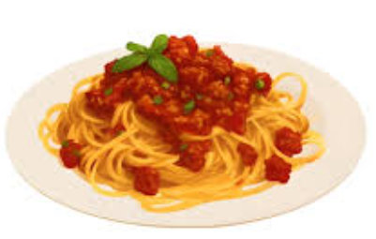

Assessment
Question 2 What is the best way to wash your hands?
___________________________________________________________ ___________________________________________________________ ___________________________________________________________
Question 1: What 5 things do humans and animals need to survive?
Question 4 What happens to our body when we exercise?
Question 2 Bill is having spaghetti Bolognese for his dinner. What could he add to make it a balanced diet.
Question 5
Give an example of a carbohydrate.
_______________________________________

