Slide 1
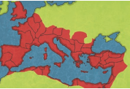
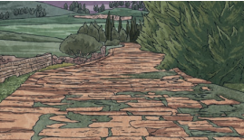
Who is Trading With Whom?
KEY VOCABULARY
Trade | The action of buying and selling goods and services.
Bartering | The exchange (goods or services) for other goods or services without using money.
Import | To bring (goods or services) into a country from abroad for sale
Export | To send (goods or services) to another country for sale.
Manufacturing | The making of articles on a large scale using machinery; industrial production
Merchant | A person or company involved in wholesale trade, especially one dealing with foreign countries or supplying goods to a particular trade.
Fabrication | The action or process of manufacturing or inventing something.
Factory | A building or group of buildings where goods are manufactured or assembled chiefly by machine.
Comparison | A consideration or estimate of the similarities or dissimilarities between two things or people.
The Romans
The first Romans lived in Italy over 3000 years ago. They founded the city of Rome in 753 BC and, over the centuries, conquered many lands to create a huge empire.
Roman roads
The Roman army are famous for building long straight roads to trade. Special engineers planned these roads and they criss-crossed the whole Roman Empire.
Trade in Bristol
Before the 16th century The Bristol mint was established. The mint produced silver and gold coins. In the 17th century, Bristol began trading with West Indies and North America. The main exports were tin, lead, fish, butter and cheese. In the 18th century, population in Bristol grew rapidly. The exchange was build as a corn and trade exchange. Bristol was involved in slave trade and manufactured goods such as woollen cloth, brass and iron goods.

Slide 2
Assessment

