Slide 1
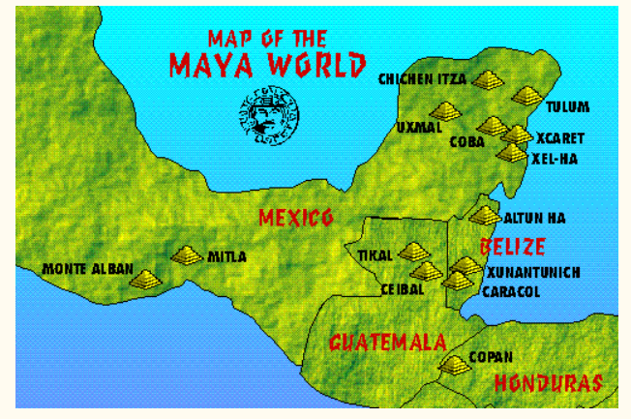
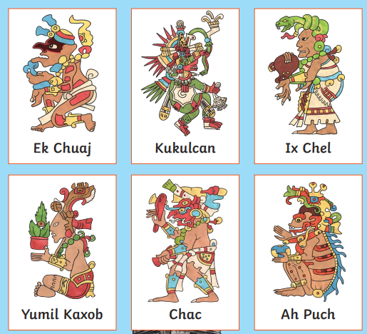
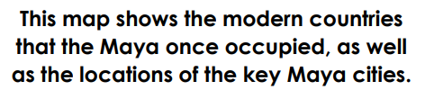
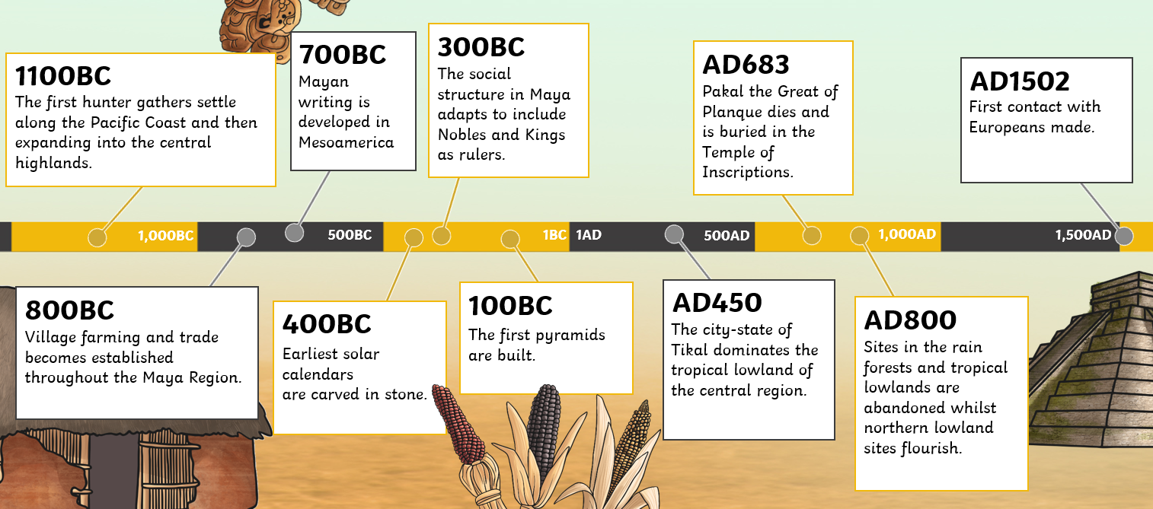
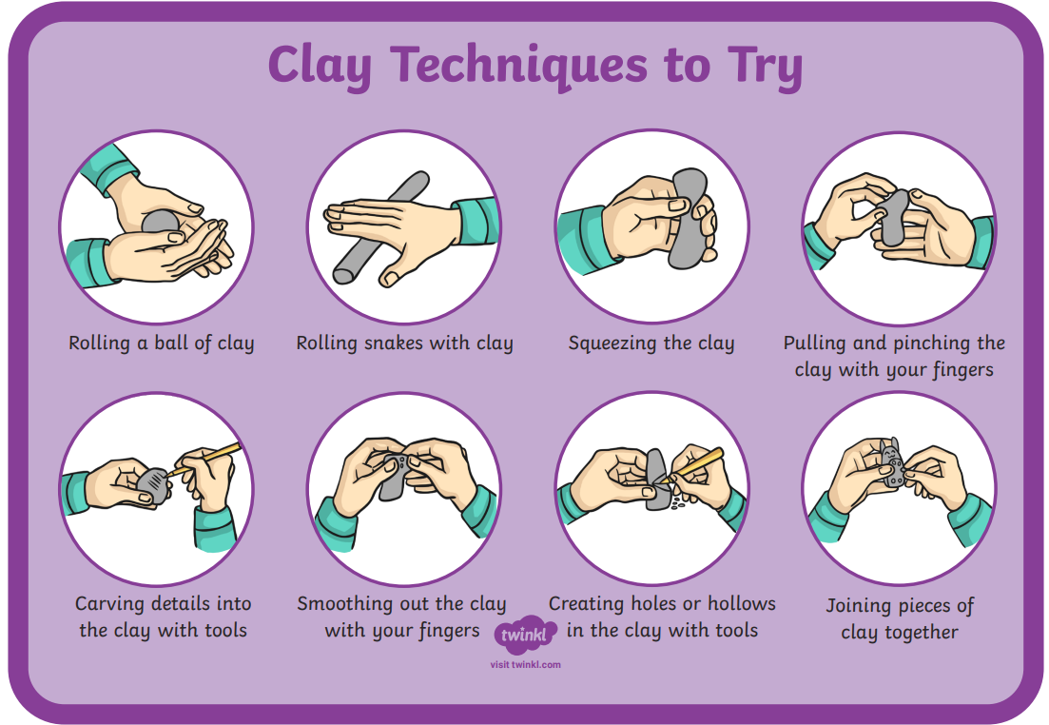
How Can We Show What We Believe In?
ESSENTIAL VOCABULARY
artefact | An object that is made by a person such as a tool or a decoration especially one this is of historical interest.
civilisation | A human society that is organised.
sacrifice | Giving up something as an act of worship.
primary source | A source that comes directly form the time of the event e.g. an artefact.
secondary course | A source that is created after the event and often created using primary sources e.g. a text book.
hierarchy | A system that ranks things, often in order of power or importance.
dynasty | A series of rulers who are all form the same family or a period when a country is ruled by them.
empire | A group of countries ruled by a single person, government or country.
temple | A building used for the worship of a god or gods in some religions.
worship | To have or show a strong feeling of respect or admiration for God or a god.
slip | A liquid that joins clay.
score | Marks where materials will be joined together
What did the Ancient Maya believe in?
The Maya worshipped many gods and performed ceremonies to keep them happy. They worshipped them like kings and queens and believed they had a big influence on their daily lives.
Maya Daily Life
Ordinary Maya citizens lived in one room houses built from mud and timber. Men were responsible for providing for their families, women would prepare food and clothes and the children would learn these skills from their parents. Maya people would eat meat as well as their own grown crops, but maize was their staple food. The cacao bean was used to make a drink for the ruling classes.

Slide 2
Assessment

