Slide 1
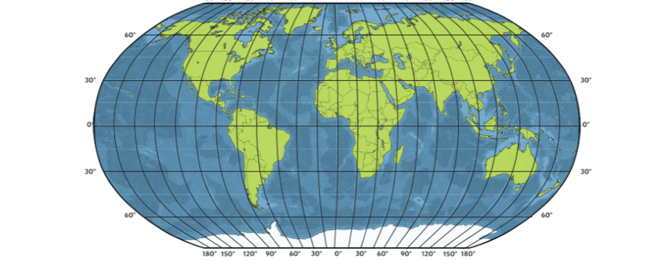
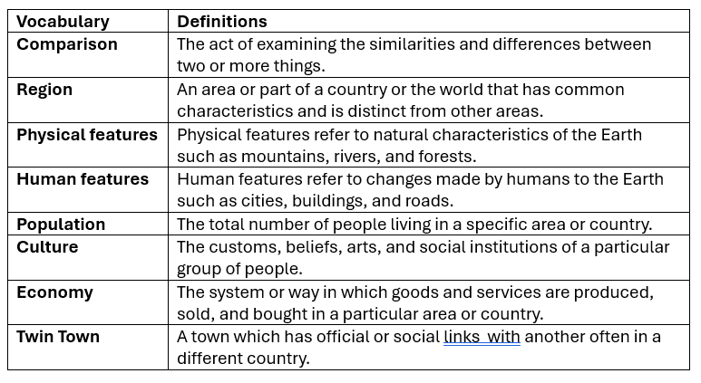
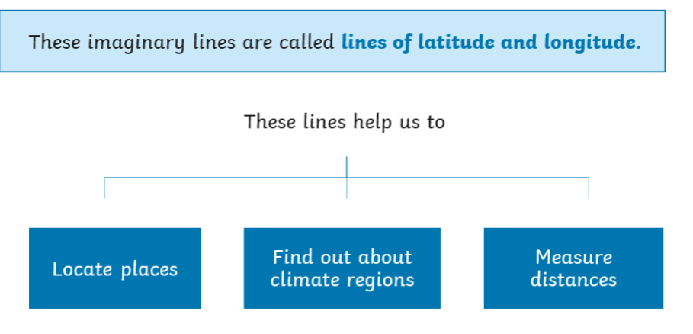
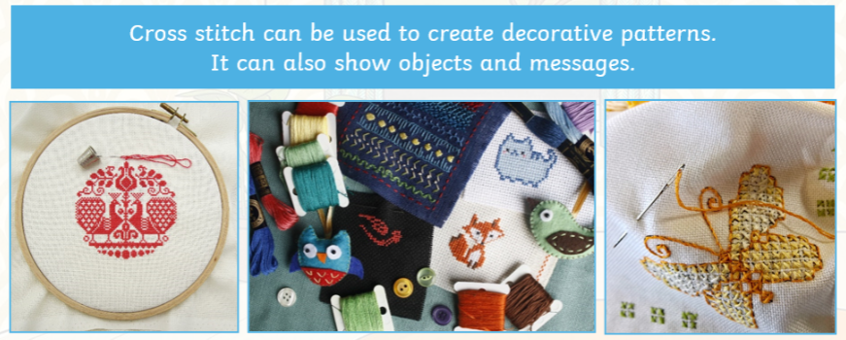
Where Is Our Twin?
Purpose of Twin Towns
The purpose of twin towns is to share ideas, learn about other’s cultures, and help each other out. People from twin towns might visit each other, have student exchanges or work on projects together.
Twin Towns of Bristol
Bristol is twinned with 7 other cities, Porto, Bordeaux, Hannover, Tbilisi, Puerto Morazán, Beira, Guangzhou.
Latitude is the distance measured in degrees east or west from an imaginary line called the Prime Meridian, which runs from the North to the South pole
Longitude is the distance measured in degrees from north or south from an imaginary line called the equator, which circles the Earth halfway between the North and South Pole.

Slide 2
Assessment

