Slide 1
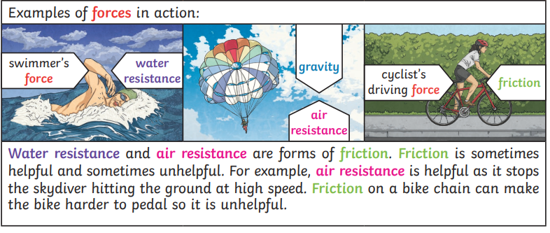
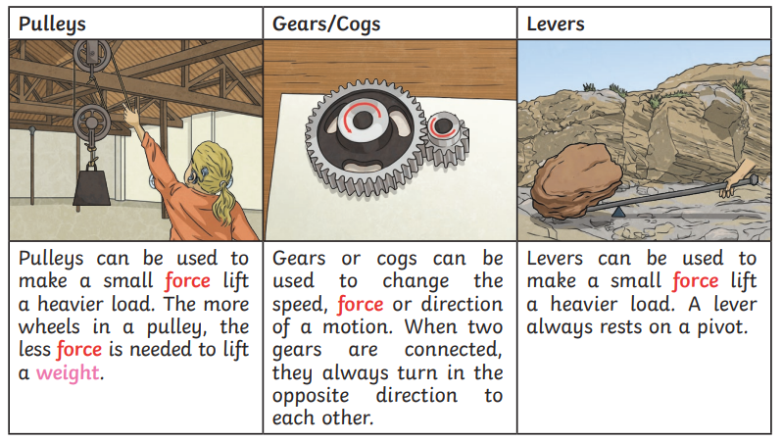
What do forces actually do?
Vocabulary.
fulcrum | The point at which a level is placed.
weight | The measure of the force of gravity on an object.
lever | Simple machines that consist of a rigid bar pivoted on a fixed point, allowing a smaller force to move a larger one.
engineer | Person that designs complex products.
distance | How much distance an object has covered in motion.
force | The force that opposes the motion of objects when they slide past each other.
power | Doing work to transfer heat or energy to cause a change.
strength | The quality or state of being physically strong.
resistance | A type of friction caused by air or water pushing against it.
Gravity | The force that attracts objects towards each other, drawing them towards the centre of the Earth.
upthrust | A force that pushes objects up, usually water.
mass | Measurement of how much matter is in an object.
pulley | Simple machines that consist of a grooved wheel and a rope or chain, used to raise or lower heavy objects.
buoyant | Able to keep something afloat.

Slide 2
Assessment

