Slide 1
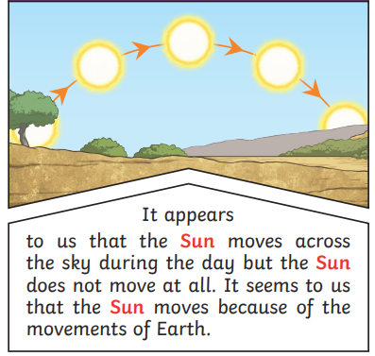
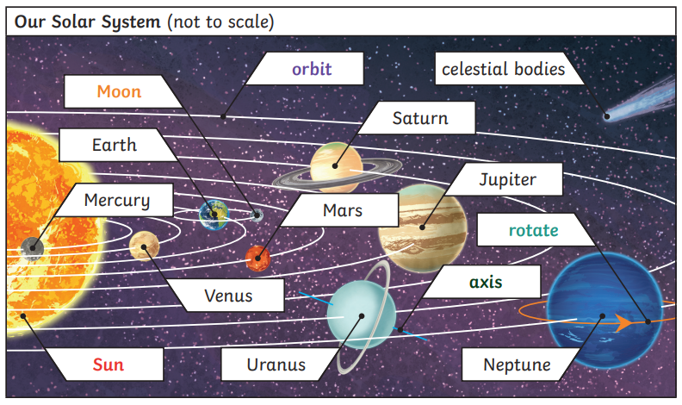
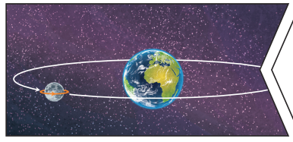
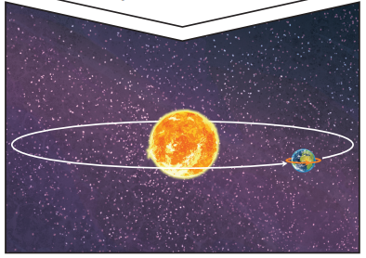
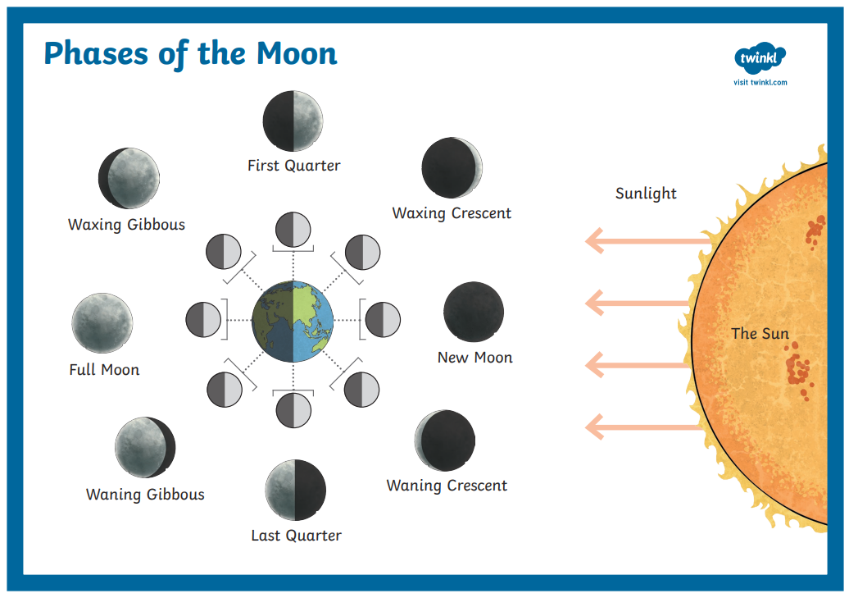
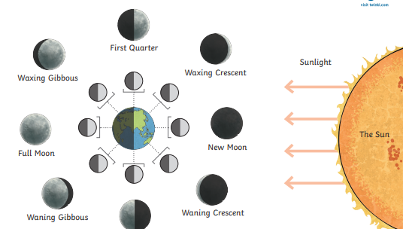
What Does the Earth Look Like From The Solar System?
ESSENTIAL VOCABULARY
Rotation | The action of rotating about an axis or centre.
Celestial Body | A natural Object that exists outside the Earth’s atmosphere.
Equator | An imaginary line around the middle of the planet or another celestial body.
Tropic of Capricorn | An imaginary line of latitude going around the Earth at approximately 23.5 degrees south of the equator.
Tropic of Cancer | An imaginary latitude line located above the equator that runs across the globe at 23 degrees north of the equator.
Sphere | A perfectly round 3D shape with one continuous curve.
Orbit | The path of an object around a particular point in space.
Latitude | An imaginary line that is used to specify the North and South side of the Earth.
Longitude | An imaginary line running from the North Pole to the South Pole.
Timezone | Is a region with standard time throughout.
Hemisphere | Half of a sphere, or ball.
Gravity | Gravity is a force that pulls everything down towards the centre of the Earth.
Axis | An imaginary line about which a body rotates.
Prime Meridian | An imaginary line that divides the Earth into two equal parts; the Eastern and Western Hemisphere.
Greenwich Mean Time (GMT) | An internationally standard time format.
The Moon
The Moon orbits the Earth in an oval shaped path while spinning on its axis. At various times in a month, the Moon appears to be different shapes. This is because as the Moon rotates round Earth, the sun lights up different parts of it.
The Earth
Earth rotates on its axis. It does a full rotation once every 24 hours. At the same time that Earth is rotating, it is also orbiting around the sun. It takes a little more than 365 days to orbit the Sun. Night occurs when the side of Earth is facing away from the Sun.
MAKING LINKS TO PREVIOUS LEARNING GOLDEN VOCABULARY
Forces
Gravity
Shadow

Slide 2
Assessment

